Slide 1
KEYW SOURCERER NGA Disparate Data Challenge
UNCLASSIFIED
Organization Name: KEYW Corporation, Inc.
POC: Mark E. Powers, Deputy Director, KEYW Geospatial Program Office
Email: mpowers@keywcorp.com
Phone: (703)864-7384
UNCLASSIFIED

Slide 2
KEYW SOURCERER Resolves Disparate Data Challenges
UNCLASSIFIED
KEYW SOURCERER was developed from 03/2014 - 05/2016 through close collaboration with NGA Analysts and key Source and Analysis Directorate Stakeholders and through a KEYW funded IR&D.
SOURCERER’s unique ability to ingest and enhance large volumes of multi-source, highly disparate data and curate the resulting content within a specific ontological context accelerates the collection to analysis processing cycle and maximizes the Analysts’ effectiveness.
What follows is a high level overview of SOURCERER which is currently ready to demonstrate upon request.
UNCLASSIFIED

Slide 3








KEYW SOURCERER: Conceptual Overview
UNCLASSIFIED
Local “Shoebox“ Data
UNCLASSIFIED Domain
Secure Domain(S)
JEMA MOW Globe
Web Harvests
Enhancement Pipeline
Data Package
Data
Storage
Metadata tagging/data profiling
Entity extraction
Junk removal
Language translation
Automated DNI Citation Generation
Targeted Research
Harvests
Enhancement Pipeline
Any Specialized
Data Domain
Raw Disparate Data
Data Conditioning
Processed Information
Finished Intel Report

Slide 4
KEYW SOURCERER Resolves Disparate Data Challenges
UNCLASSIFIED
Ingests highly disparate data from any source (including WWW)
Developed by KEYW with NGA Analysts to meet unique needs of a global IC
Includes 40+ Open Source, and GOTS applications (low cost) – “Plug-n-play” Service Oriented Architecture (SOA) so new capabilities can be plugged in as they emerge
Currently operating on AWS w/ Cloud Formation - environment independent portability
Enhances and optimizes disparate data in preparation for advanced analytics
Complies with Intel Oversight and Government data collection policies (EO 12333) - Helps triage unwanted or accidental data collections (US PERS)
Creates data collections to manage research, collaborate in teams, or share topic-focused datasets with others
Bolsters existing Intel with rich OSINT and SOCMINT context from an unlimited number of data sources and data types
UNCLASSIFIED

Slide 5
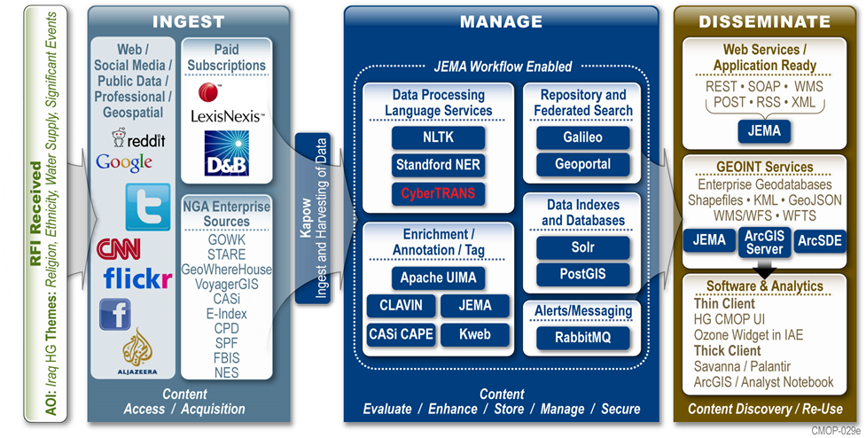
KEYW SOURCERER: Baseline Architecture
UNCLASSIFIED

Slide 6
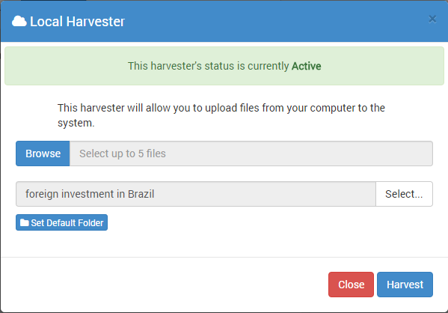
KEYW SOURCERER: Content Deposit & Management
UNCLASSIFIED
Analysts can quickly deposit locally stored or external data to unify stovepipes and rediscover existing enterprise content
Automatically enhance, index and run other processing for discoverability (background processing)
Prevents ingest of duplicate data (MD5 Hashtag Gatekeeper)
URL Deposit
Local Deposit
Web Harvest
KEYW
SOURCERER
UNCLASSIFIED

Slide 7
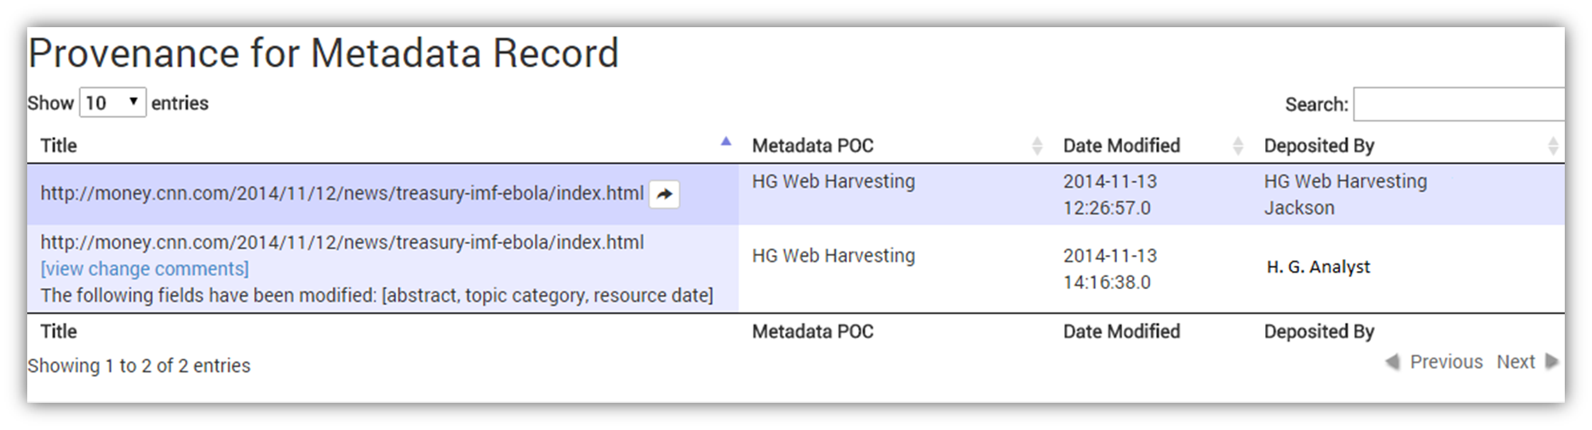
KEYW SOURCERER: Open Source Research
UNCLASSIFIED
SOURCERER can automatically harvest, enhance, and organize disparate data types and sources by targeting URLs or content sources identified to contain important information
Capture Websites for topical context
Capture specific files with mission value
Schedule harvests to find data (data ingest as a service)
Track Provenance & actions for every data type for intelligence oversight, metrics analysis
UNCLASSIFIED

Slide 8
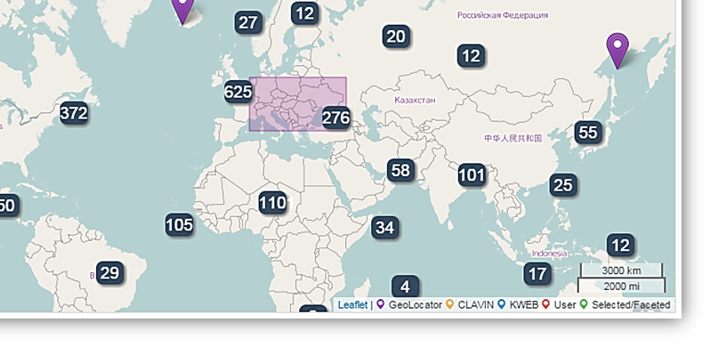
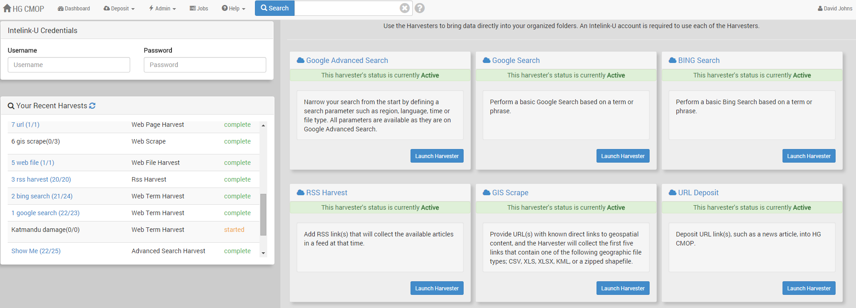
KEYW SOURCERER: Harvesting
UNCLASSIFIED
SOURCERER can innocuously target and collect content from ANY source using a vast library of specialized, customizable harvesters
Boolean search driven harvests utilizing popular search engines
Target and harvest GIS, Imagery, or other files directly
Utilize APIs or create new harvesters to generate services from previously untapped sources
Multi-source Harvest Dashboard
Bounding Box
Content Search
Customized Harvesters

Slide 9
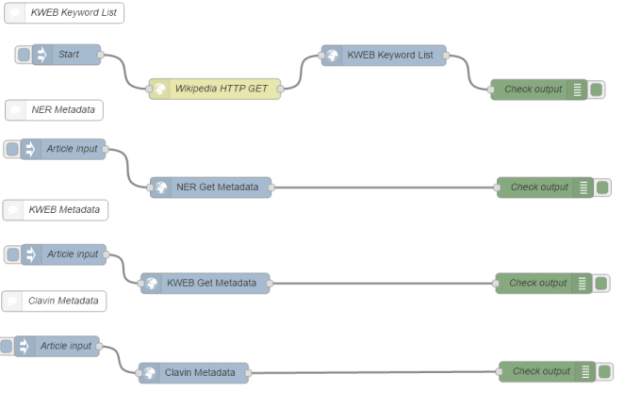
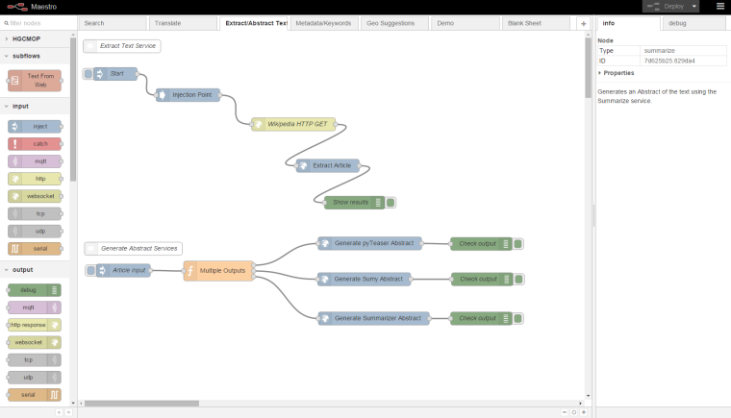
KEYW SOURCERER: MAESTRO Service Orchestration
UNCLASSIFIED
TM
Integrate existing or new services into SOURCERER’s Dynamic Pipeline Creator – Add services as new data types emerge from new data sources
Stitch together micro-services to create unique and or repeatable processes in a customized & automated Data Enhancement Pipeline
Share data harvest & enhancement workflows with other Analysts
Geotagging
Data Storage
Text Extraction
Language Translation
Data Indexing
Entity Extraction
Data Profiling Services
Drop & Drag
Programming
Programmable Whiteboard

Slide 10
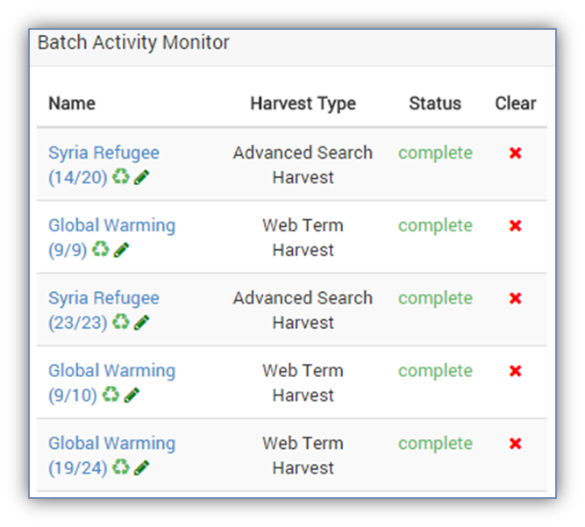
KEYW SOURCERER: Enhancement Pipeline
UNCLASSIFIED
Add Context to any Content
Optimizes disparate data types for its ultimate purpose (analysis)
Automates manual and time-consuming data conditioning tasks
Filters and facets all data based on ontological themes or keywords
NMF compliant w/ automatic tagging, NAS Profiling
Automatically generates mandatory DNI formatted data citation
needed for Intelligence Reports (at the point of data ingest)
Harvest data from multiple sources simultaneously & as scheduled
Text & Imagery Extraction
Language Translation
Entity Extraction
Metadata Extraction
Data Profiling
Data indexing
UNCLASSIFIED

Slide 11
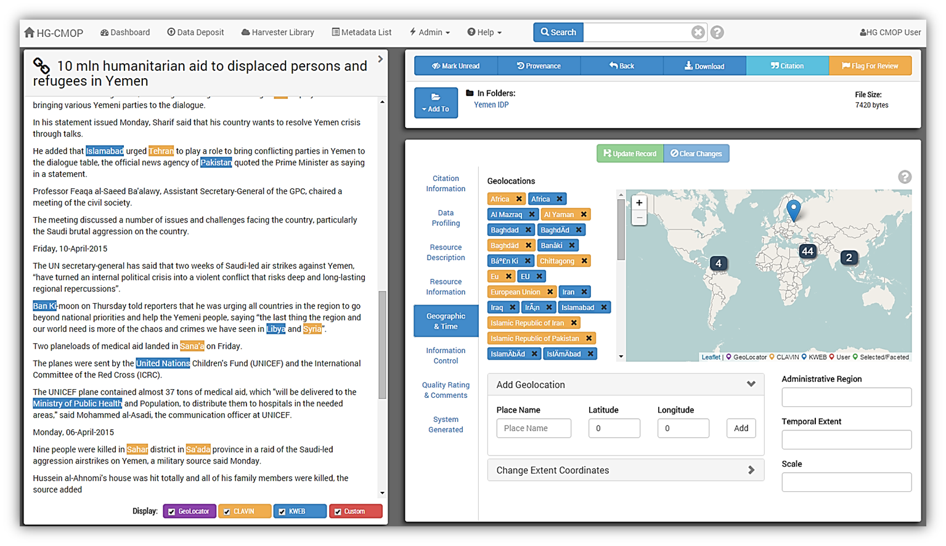
KEYW SOURCERER: Data Visualization Dashboard
UNCLASSIFIED
UNCLASSIFIED

Slide 12
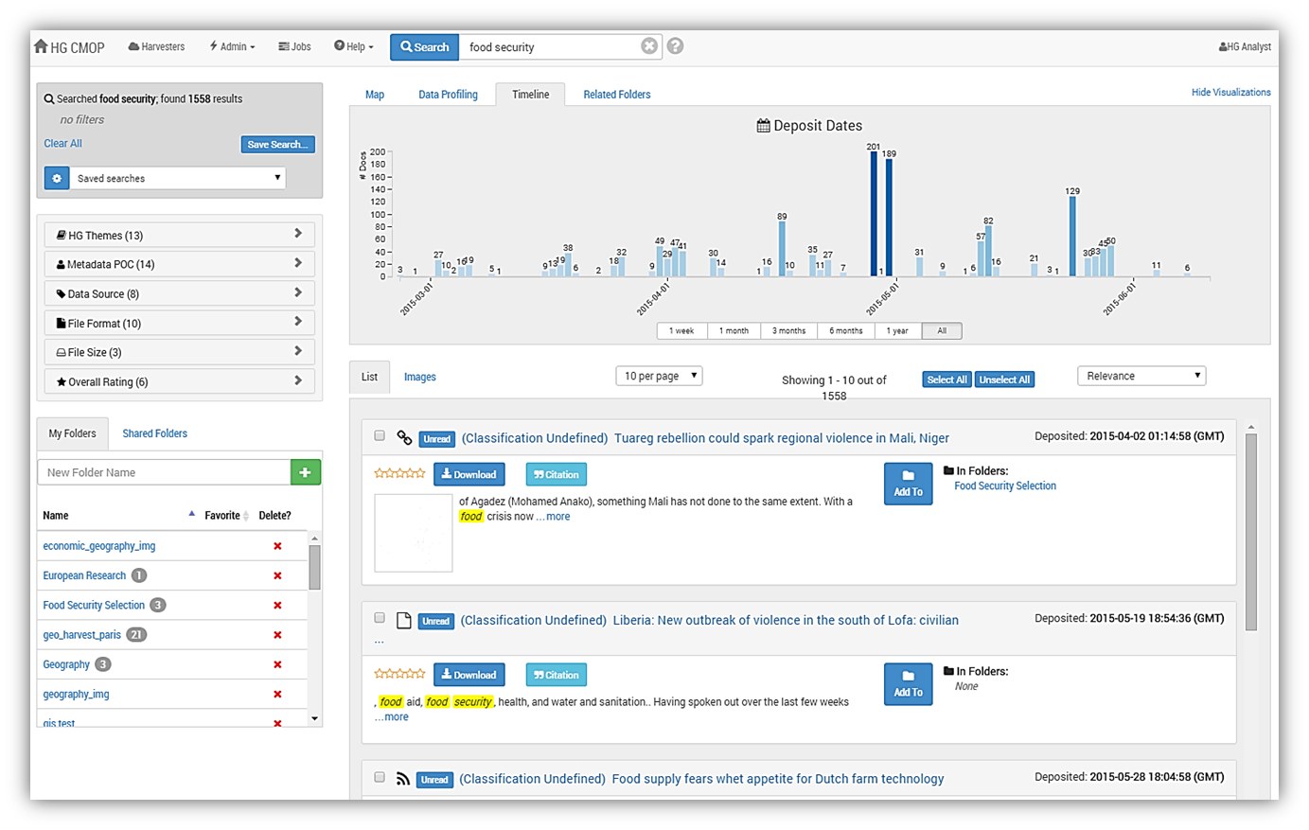
KEYW SOURCERER: Data Visualization Dashboard
UNCLASSIFIED
Filter by Ingest Date
Filter by Data Type
UNCLASSIFIED

Slide 13
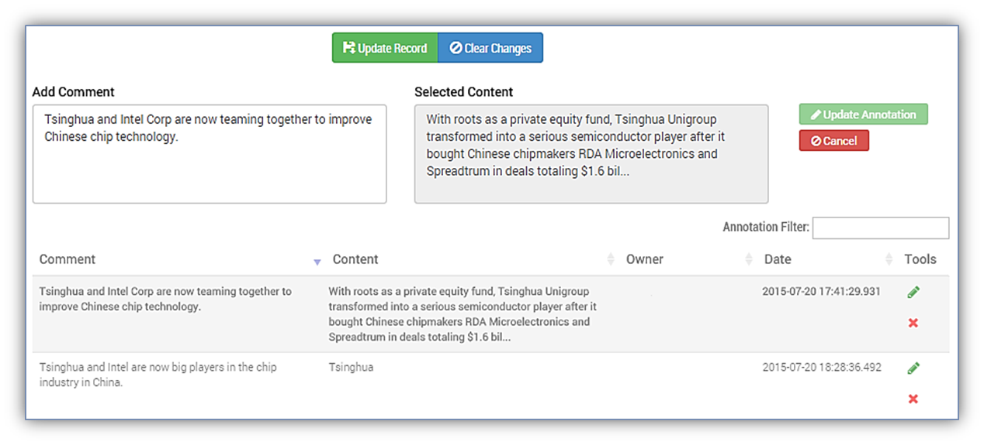
KEYW SOURCERER: User Annotations for any Data Type
UNCLASSIFIED
UNCLASSIFIED

Slide 14
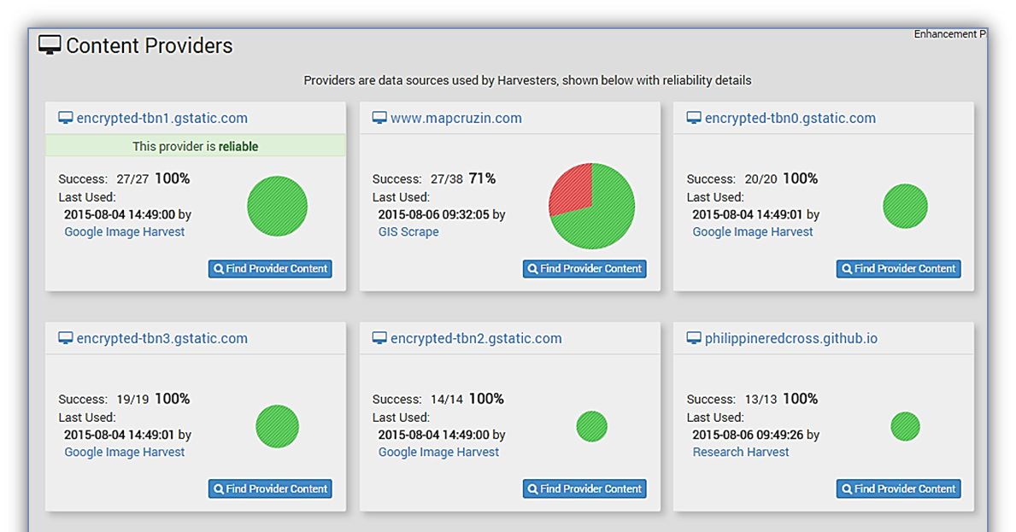
KEYW SOURCERER: Content Provider Catalog W/ Metrics
UNCLASSIFIED
UNCLASSIFIED

Slide 15
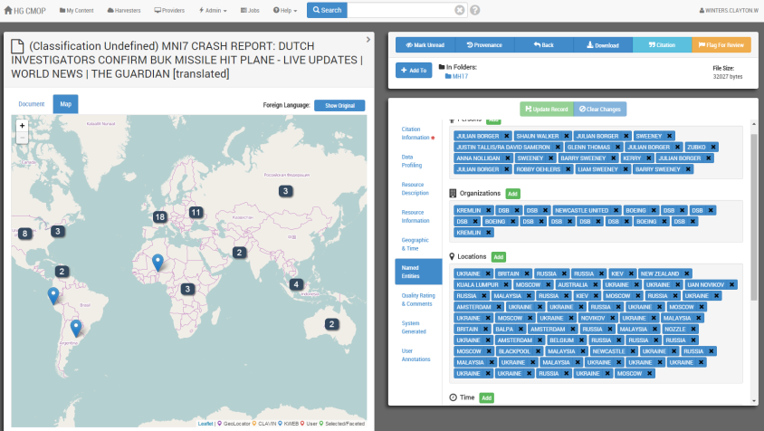
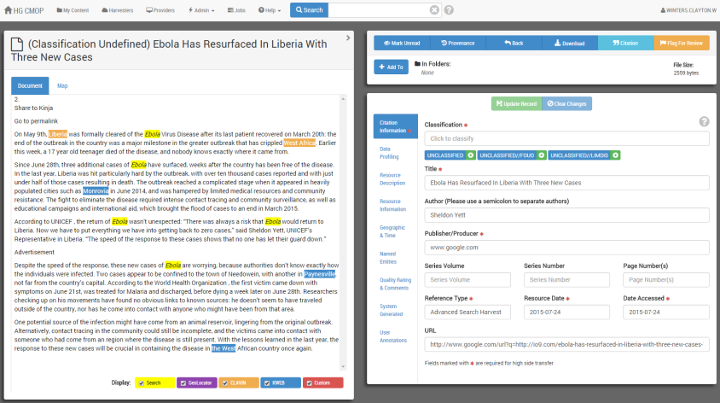
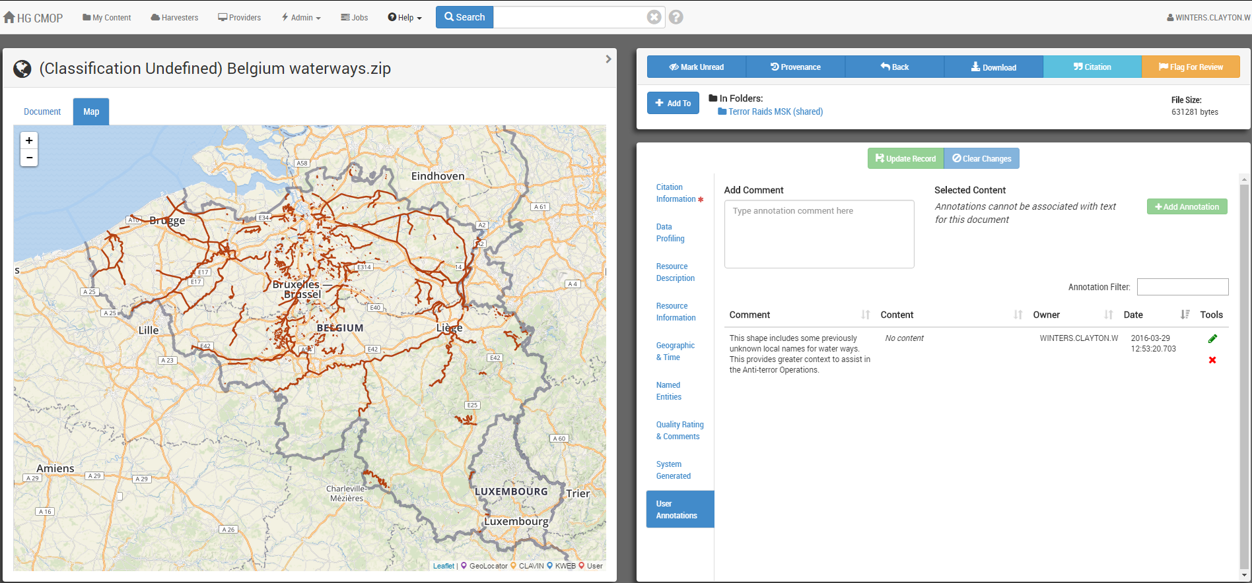
KEYW SOURCERER: Text and Entity Extraction
UNCLASSIFIED
Utilizes Free, Open Source and GOTS services to Automate the Analytic Life Cycle to Empower Data while keeping the Analyst in the loop – allows Analysts to do what they do best.
Validates automated enhancements to
Metadata
Abstract
Keywords
Entities
Ratings
Notes & Annotations
Immediate Visualization
Extracted & Cataloged Entities
Text & Imagery Extraction
Language Translation
Entity Extraction
Metadata Extraction
Data Profiling
Data indexing

Slide 16
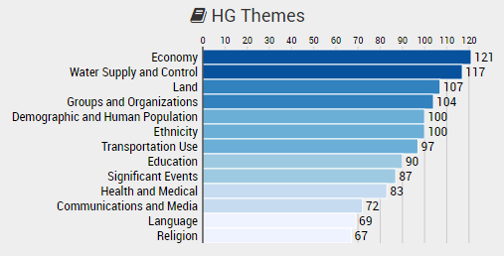
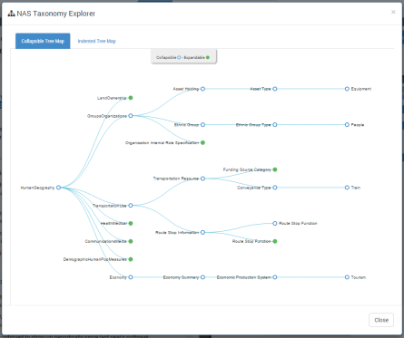
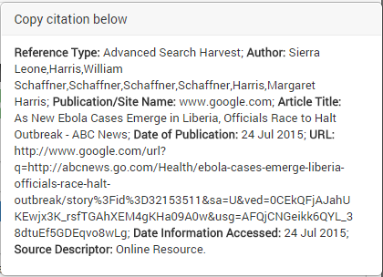
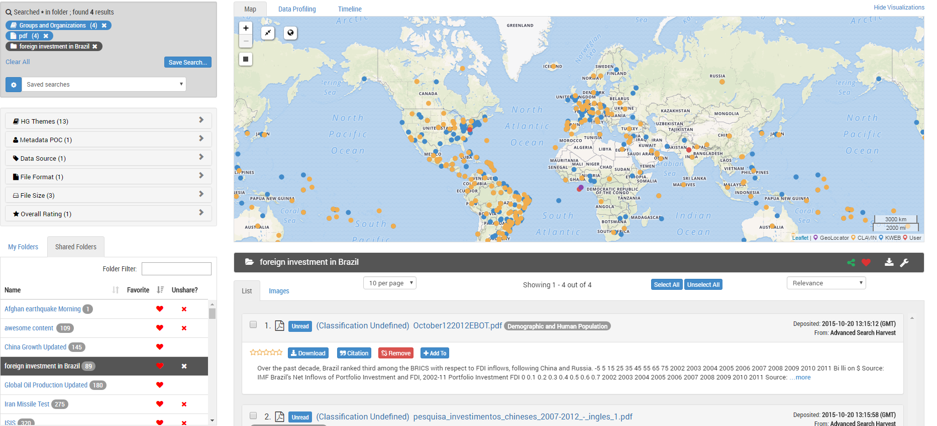
KEYW SOURCERER: Text and Entity Extraction
UNCLASSIFIED
Disparate Data Filtration & Faceting
Includes User customizable dashboards
Enables Analysts to filter and facet diverse data
sets based on mission objective, temporal, geospatial
or designated ontological framework
Automatically creates properly formatted DNI Citation
Properly Formatted DNI Citation
Data Profiling Based on NAS Standard
Disparate Data Package Visualization
UNCLASSIFIED

Slide 17
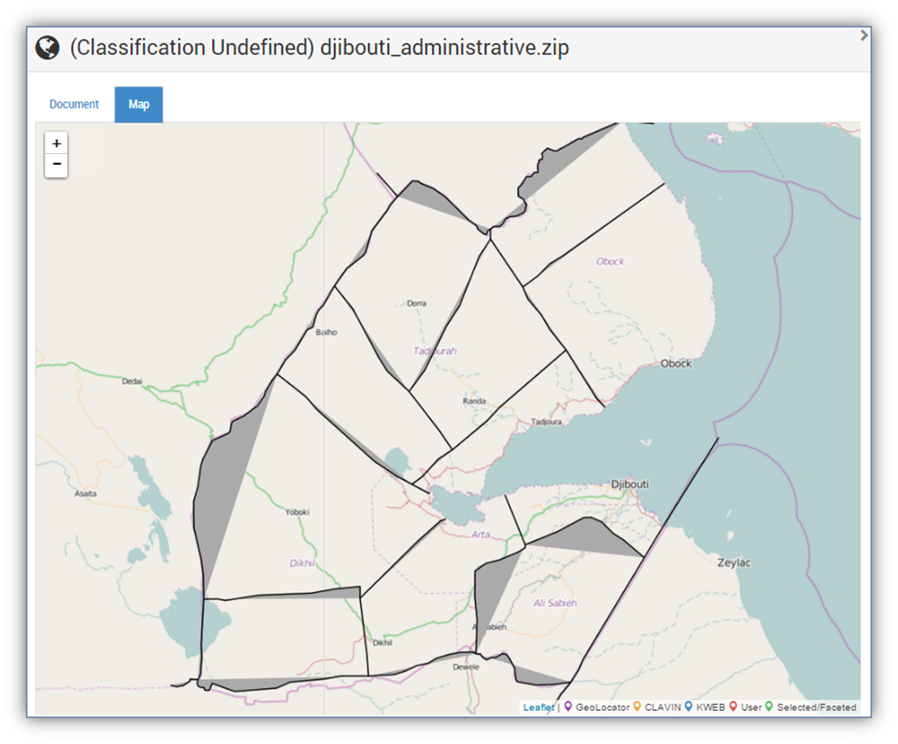
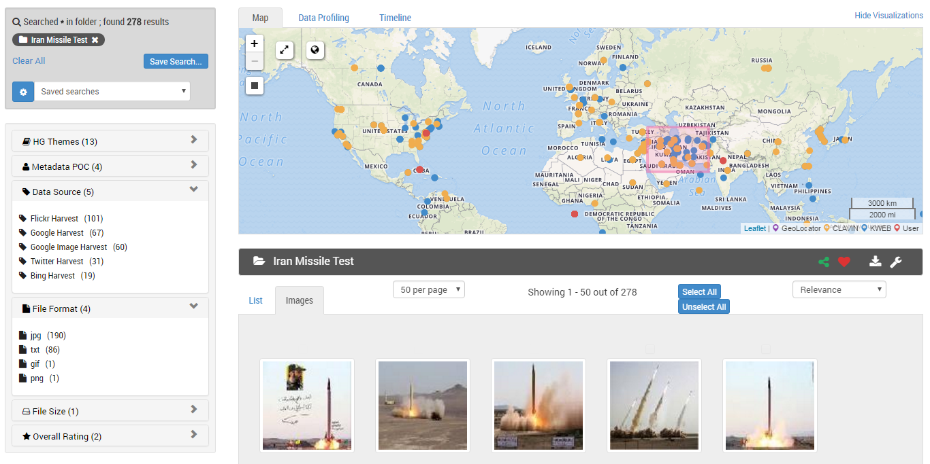
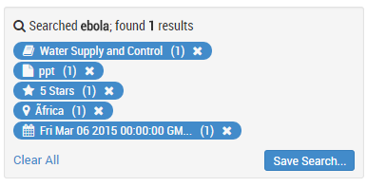
KEYW SOURCERER: Immediate Situational Awareness
UNCLASSIFIED
Empowers Analysts by bringing their workflow closer to the point of discovery.
Intuitive Interface for research, curation, & preparation of widely disparate data for advanced analytics
Analysts can create and share public or private folders to organize Analysts’ research for collaboration
Maximizes efficiency and avoids duplication of data and effort
UNCLASSIFIED

Slide 18
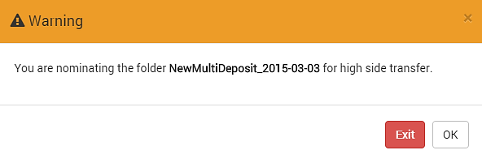
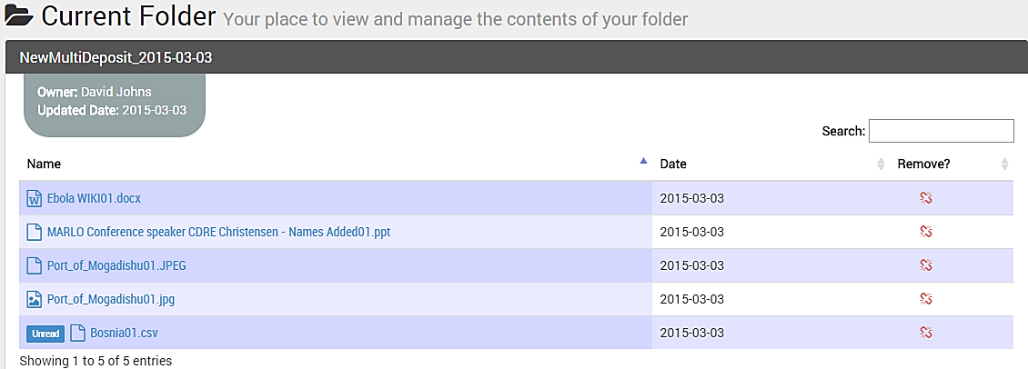
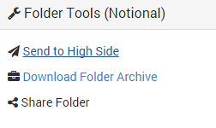
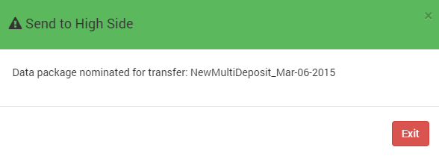
KEYW SOURCERER: Purpose-driven Data
UNCLASSIFIED
Once the data has been ingested, enhanced, and tagged, Analysts can build a data package & send it to the High Side with a single click using the integrated Cross Domain Transfer Capability!

Slide 19
KEYW SOURCERER: Unique Features
UNCLASSIFIED
SOURCERER is more than a tool, it is a philosophy based on highly-refined data processing and management techniques refined by KEYW over 10 years of IC practice
SOURCERER is currently at a Technology Readiness Level 6 (ready for operations)
It has already been integrated with MapEdit and GeoQ to create a unique capability (integration took only 4 days - demonstrating its OPEN SOLUTION architecture) – Workflow tasking (GeoQ), Dynamic Foundation Layer updates (MapEdit) and real time multi-source data infusion (SOURCERER)
It is cloud ready, scalable and self-healing (low cost, future facing & sustainable)
KEYW is already working on the next generation of SOURCERER (code name SHERLOCK) that will process and optimize over 1,800 disparate data types based on Analyst Personas which enable relevant data to find the Analyst based on observed Analyst activity, pre-described KIQs, customized workflows and scheduled harvests
SOURCERER is the foundation for dynamic, real-time, self-populating, multi-source, and mission relevant Intelligence Reports
UNCLASSIFIED

Slide 20
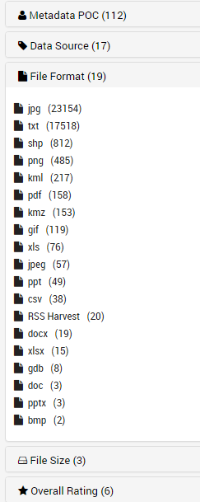
KEYW SOURCERER: Demonstration (Phase 2)
UNCLASSIFIED
SOURCERER is ready to demonstrate and currently has the ability to process the following data types (more data types can easily be added):
If selected for Phase 2, KEYW will demo KEYW SOURCERER using the Humanitarian Data Set.
To access KEYW SOURCERER, please visit:
NOTE 1: CAC Card is required to obtain access
NOTE 2: For the purposes of word count, objects outlined by a red boarder are either graphics or screen shots and were not included in word count.
https://www.opensourcerer.us/hgcmop/home
UNCLASSIFIED

